Slide 1
ALCOHOL SAFETY
LOSS PREVENTION
OFFICER TRAINING SEMINAR RICHARD MARTIN, PDD
Notes:
We must do better with Alcohol Safety and Loss Prevention. Lets look at an actual lawsuit

Slide 2
Quote from the Accident Prevention/Insurance Risk
Newsletter, Summer 2022.
“SERVICE OF ALCOHOL
State Accident Prevention Chairs and Lodge Accident Prevention
Managers should continuously repeat the message about alcohol.

Slide 3
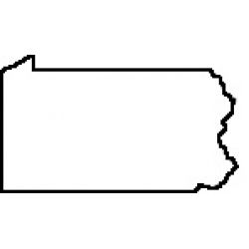
The Membership must be reminded of a $28,000,000 verdict against Lodge Officers and Lodge Members in Pennsylvania.
REMINDER
A jury found that a nonmember was
improperly served alcohol while
attending an Elks sponsored
function.”
Notes:
It is against the Florida Law to sell to non members. Florida Administrative Code chapter 61A-3.019

Slide 4
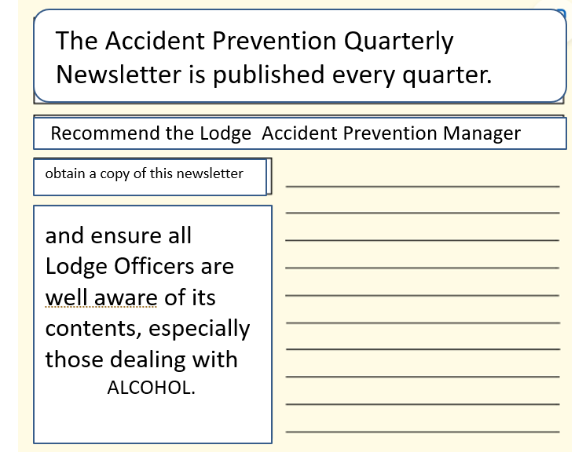

Slide 5
The Lodge Accident Prevention manager should ensure every Lodge Officer reads and understands the Liquor Liability for Elks, written by C. Mark Vazzana and the Responsible Beverage Service.
Both are on:
Florida Elks website, in Business Practices Library.
Notes:
This is information that has been in the Business Practices Library for a number of years

Slide 6
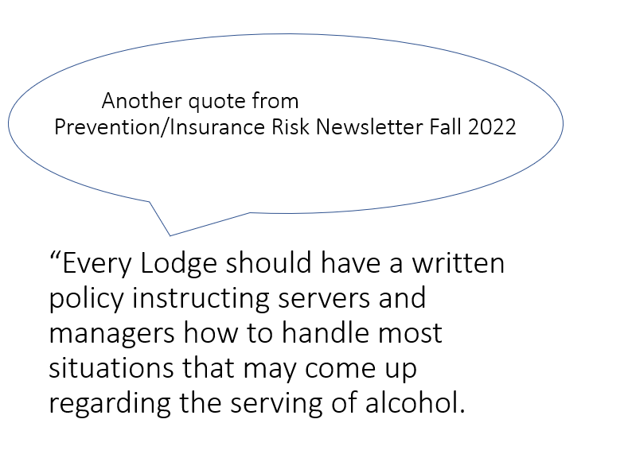

Slide 7

Rules regarding Visibly Intoxicated
Persons could help reduce your risk of liability.”

Slide 8

Grand Lodge Statute,
Section 17.052 states:
“Each Lodge shall enact and have in force a House Rule prohibiting the over service of alcohol as defined by local law or ordinance.”
Notes:
How are you, the Lodge officers going to ensure the directive is being enforced if you do not know what the local laws are? Would a
Written policy help?

Slide 9

“It is the Lodge’s duty to create a safe and congenial environment for its members. Lodge facilities are not places of public accommodation; Lodges must maintain strict compliance with this rule.”

Slide 10

Where can we find information concerning Alcohol Safety and
Loss Prevention?
We must because Alcohol related verdicts are in the multi millions of dollars.

Slide 11
(1) Grand Lodge Statutes Annotated
(2) Grand Lodge Liability Insurance Program
(3) Exalted Rulers, Lodge Officers, Committee Members Manual
Notes:
I will be introducing eight areas

Slide 12

(4) Accident/Claim Prevention
Manual
(5) Accident Prevention Quarterly
Newsletters
(6) Liquor Liability for Elks
(7) Responsible Beverage Service

Slide 13
(8) Florida Department of Business and Professional Regulations (dbpr)
The first four references are on the Grand Lodge website and listed under “Manual” https//www.eks.org
Notes:
Eight references have been listed. The Exalted Ruler, every member of the House Committee and Lodge Accident Prevention manager
MUST know what is in these references regarding Alcohol.

Slide 14
The fifth item listed is on the Grand Lodge website and is under “Safety & Insurance”
The sixth and seventh references are on the Florida Elks website and in the Business Practices Library https://floridaelks.org

Slide 15

The last reference, dbpr, contains
State of Florida’s statutes and rules for beer, wine, and liquor. www.myfloridalicense.com/DBPR/
“Florida DBPR Statutes & Rules” is on
Florida Elks website and is in the
Business Practices Library. It is highly recommended each Lodge becomes very familiar with this document.
Notes:
Click on Instant Public Records, Alcoholic Beverages and Tobacco, Statutes & Rules

Slide 16
Grand Lodge Liability Insurance Program VIII. Alcohol Safety provides guidelines for service of alcoholic beverages. pages 26, 27, and 28.
Notes:
Lets look at information is some of the documents

Slide 17

Exalted Rulers, Lodge Officers,
Committee Members Manual page 21 is very similar to page 27 in the Liability Insurance Program.
It also identifies Important Notice
Regarding the Service of Alcohol and Alcohol Service Training

Slide 18
Accident/Claim Prevention Manual page 7, Guidelines for Service of
Alcoholic Beverages, is also very similar to the previous two references.
Notes:
Is the Grand Lodge trying to tell us something by putting the same information in three different manuals?

Slide 19
All three of the previous reference documents state,
“I. Lodges must comply with all state and local laws – Lodge management and anyone responsible for serving alcohol must be aware of these requirements.”
Notes:
To put together a written policy for your lodge, This would be a very good starting point

Slide 20
The previous documents also state:
“Liquor claims are few in number but cost the Order many times more than any other type of claim.”
When a bartender serves a nonmember and non-member pays for the alcoholic drink,
Florida Law was broken and a claim could result.
Notes:
This is one of the many reasons for Section 17.052 in the Grand Lodge Statutes. We can no longer continue to do business at what
has been done in the past.

Slide 21
Accident/Claim Prevention Manual, page 4, item IV.
Recommended Training Policies/Procedures. As stated, these training policies and procedures shall be followed by every Lodge.

Slide 22
Every lodge bartender whether they are an employee or a volunteer, must be trained.
A document for each bartender should be put in their folder showing they have been properly trained.

Slide 23
The following are examples of where training can be obtained:
PSP Vincent Como is certified to train personnel
TIPS Training (800) 438-8477 or visit gettips.com https://tipscertonline.com

Slide 24
Florida Administrative Code
Chapter 61A-3.019 Club Licenses.
“All clubs licensed under beverage law must adhere to the following regulations:” There are 12 listed and the Lodge is required to know all 12.
First one “(1) Alcoholic beverages may be served only to bona fide club members or to their guests.

Slide 25
The payment for such service and distribution must be made by bona fide club member.”
The only exception to this rule is when the Lodge has obtained a
1,2,or 3 day permit and there are rules that must be followed.
Notes:
With this permit, the lodge MUST use their own trained bartenders. Self service of any type is not allowed

Slide 26
Items to keep in mind:
1. Comply with all state laws
2. Ensure all bartenders are trained
3. Never serve an intoxicated person
4. Make an incident report on all alcoholic issues. Keep 2 years
5. This is just a start.

Slide 27
WEB SITES https://www.elks.org https://floridaelks.org www.myfloridalicense.com/DBPR/ click on
*Instant Public Records
*Alcoholic Beverages and Tobacco
*Statutes and Rules
Notes:
There is a lot of information on these web sites, I just passed on to you where to go with just a little information from each area. With the
areas identified, each Lodge can start building their written policy and a good person would be your Lodge Accident Prevention Manager
Prevention Manager.

